Slide 1
St. Joseph Faith Formation Office of Religious Education Opening Prayer: Our Father, Hail Mary, Glory Be

Slide 2
PARENT RESPONSIBILITY AND ROLE
Parents are the first educators of their children in the ways of faith and their spiritual formation. Your cooperation and support in the following ways is vital to his/her understanding of our Catholic Faith and the growth of his/her relationship with Jesus.
Prayers may be learned in what ever language the parent and child decide.
The need to know the following:
Sign of the Cross The Our Father The Hail Mary
The Glory Be Act of Contrition
Prayer Sheets were provided in the Registration Packet & are available on the Parish website, in the Religious Education tab.

Slide 3
Mass Attendance
Each child will be given a sheet with “tickets” that need to be filled out each Sunday and placed in the collection baskets during Mass.
Parents and students must go to the parish website to view the Mass Journal sheet and answer the questions listed- the paper must be brought to class each Wednesday. This journal page can be written on any notebook paper so long as the questions are answered.
There will be a basket in the Parish Hall where they can drop off this Mass Journal each week.
*If you attend a different parish for Sunday Mass, the Mass Journal still needs to be filled out.*

Slide 4
Parent Meetings
As it is parents’ responsibility to teach their children in the ways of Faith, the parish stands ready to help by having meetings with and for the parents thorough out the year. These meetings are mandatory. These meetings will be help throughout the year.
Dates:
October 9, 2023 November 13, 2023
December 2023 January 16, 2024
March 2024 April 22, 2024

Slide 5
Reconciliation
First Holy Communion
Mandatory Retreat
Child & 1 Parent/Guardian
Saturday, Feb 10, 2024
Location: Parish Hall
Time: 9:00am-1:00pm
Sacrament of Reconciliation
Saturday, March 2, 2024
Location: Church
Time: 9:00 am
Mandatory Retreat
Child & 1 Parent/Guardian
Location: Hall
Time: 9:00am-1:00pm
Saturday, April 13, 2024
Sacrament Rehearsal
Wednesday, May 13,
Time: 6:30pm-8:00pm We will start off in the Hall.
Sacrament of Holy Communion
Location: Church
Time: 9:00 am
Saturday, May 18, 2024
FOR BOTH SACRAMENT DAYS:
Children MUST arrive no later than 8:30am

Slide 6
RCIC Year I
RCIC Year II
Saint Report due January 17, 2024
*Form was given in registration packet*
Please sign up for individual parent meetings with Mrs. Puerto
Rite of Election- 9:00am:
February 18, 2024
Scrutinies – 9:00am:
1st- March 3, 2024
2nd- March 10, 2024
3rd- March 17, 2024
Sacraments:
Saturday, April 6, 2024
9:00am – 12:30pm

Slide 7
Catechist Role & Qualifications
The catechist provides (teaches) the special information necessary for each grade and sacrament.
Catechists are volunteers who are willing to spend their time and talent in sharing their faith with the children of the parish.
All Catechist are fingerprinted per Diocesan Policy
Attend Safe Environment Training.
Participate on ongoing formation.
Be in good standing with the Catholic church

Slide 8
Student Responsibility and Expectation
Students are expected to cooperate and behave in ways that encourage the learning of all in Religious Education: living as children of God; treating each other with respect courtesy and kindness.
Students are expected to complete their assignments and participate actively in class and projects
There is no eating in the classrooms
NO CELLPHONES: Classrooms are electronic-free; device usage is up to Catechist discretion

Slide 9
Student Responsibility and Expectation
Each student is responsible for equipment and supplies he/she uses. If damage occurs, parents will be asked to pay for repairs or replacement. We ask that children in the Religious Education Ministry respect the property of other students at St Joseph School. Nothing should be removed or used from the desk and classroom they are sharing.
If your child loses their book, it will cost $30 to replace it- a fee of which the parents MUST pay. Due to the high volume of students in the program, we do not have extra books in the Office.

Slide 10
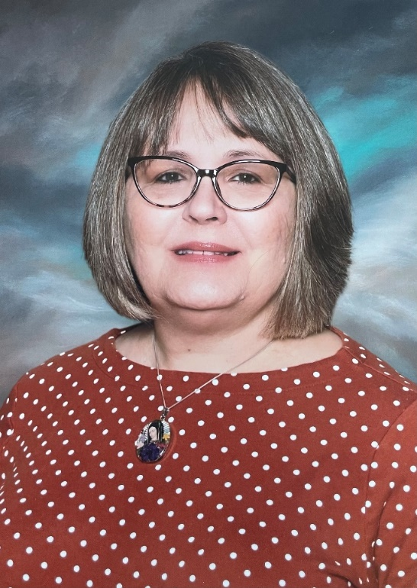
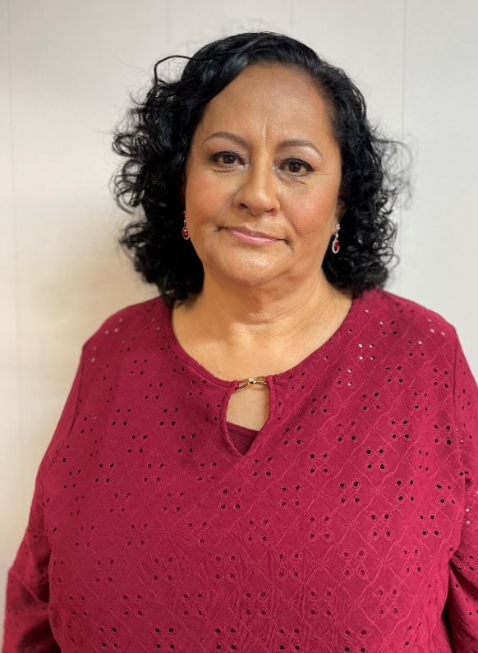
General Information
Office Hours
Monday – Thursday 4:00pm-8:30pm
Director of Religious Education
Diana Puerto
dpuerto@sbdiocese.org
(909) 981-8110 x29
Assistant Religious Education Director
Maria Hermosillo
mhermosillo@sbdiocese.org
(909) 981-8110 x26

Slide 11
ATTENDANCE
Participation in parish events is heavily recommended in order to grow in our community of faith.
Retreats, Sacrament Rehearsals, & Sacraments are mandatory to attend.
If your child is ill or will not be attending class for any reason please call or email the Religious Education Office before class time and let us know. If we do not receive a note or hear from the a parent prior to the next class, the absence is unexcused.
Excused absences includes a students’ illness, school camp, dr./ dentist appt. or death in the family etc. (SPORTS PRACTICE OR GAMES ARE NOT EXCUSED)
Your child cannot miss more than 3 unexcused classes. After which, they will be dropped from the program.

Slide 12
TARDIES
Being on time is important for the lesson content presentation, especially in light of the short time the children are here. When a child comes in late it distracts the other children, disrupts the catechist and the lesson being taught.

Slide 13
DISCIPLINE
First Offense: Verbal warning from the Catechist. Parent will be notified.
Second Offense: Student is sent to the office for disciplinary visit; parent will be notified for a parent/Catechist/Director conference
Third Offense: Meeting with the Pastor to discuss course of action (Parent, Catechist, Director, Pastor)

Slide 14
ARRIVAL AND DISMISSAL
SAFETY
EARLY DISMISSAL
Parents are to park their car and walk their child to the hall.
Please do not drop off your children at the parking lot entrance or let them walk across the parking lot unattended or walk to another location for them to be picked up.
The child is only released to those whose names that appear on the emergency form. In the case of an emergency and someone else will be dropping off/picking up your child, please call the Religious Education Office to let us know.
If you arrive late to class please come into the Religious Education Office.
If you plan to pick up your child before the class time ends you must come into the Religious Education Office and sign out your child. The child is only released to those whose names that appear on the emergency form

Slide 15
EMERGENCY AND EARTHQUAKE PROCEDURES
In the event of an earthquake, all students and adults, when it is safe, will evacuate the building according to the emergency plan and assemble in the field. Parents and/or designated family members on emergency card will be allowed to pick up the children.
Parents are strongly advised to go to our parish website and familiarize themselves with our emergency plans.

Slide 16
Safe Environment Class
During the school year, the children will receive 2 classes concerning different types of abuse prevention; mental, physical, sexual.
The Diocese of San Bernardino is in the process of implementing a new Safe Environment program; parents will be invited to see the material should they ask as soon as we receive it from the Diocese.

Slide 17
Sacramental Preparation for First Reconciliation and First Eucharist
Our Sacramental preparation is a two year process, starting with the second grade.
A guideline for readiness is given. Student’s readiness is Sacramental Preparation for First Reconciliation and First Holy Communion is determined by the catechists in a variety of ways which include oral and written testing, oral interviews and other process which may deem necessary.
Readiness is not determined by age or grade.

Slide 18
CLOSING PRAYER
God of Mercy, thank you for this community of faith.
Bless the work of our Catechists, the efforts of our parents, and the growth of our children.
Let us continue to build your Kingdom in a way that pleases you.
We ask this in the name of Jesus Christ, our Lord.
Amen.

